Slide 1

HE5091
Principles of Economics
Lecture 12
Exchange Rate, International Trade and Capital Flow
Tan Khay Boon
Email: khayboon@ntu.edu.sg

Slide 2
Topics
Exchange Rate Determination
Flexible and Fixed Exchange Rates
Nominal and Real Exchange Rates
Purchasing Power Parity Theory
Trade Balance and Net Capital Inflows
International Capital Flows
Reference: FBAH or FBL, chapter 26

Slide 3

Importance of Exchange Rates
Domestic purchases are made with local currency
  Purchasing goods abroad requires converting your local currency to their local currency
    The exchange rate measures the rate of conversion
Exchange rates are set in the foreign exchange market
  Rates are determined by supply and demand forces
  Affect the value of imported goods and the value of financial investments made across borders
Changes in exchange rates can have a significant effect on trade dependent economies

Slide 4
Nominal Exchange Rates
The nominal exchange rate is the rate at which two currencies can be traded for each other
Two definitions of exchange rate:
(1) Number of foreign currency for one local currency
(2) Number of local currency for one foreign currency
For consistency, use definition (1)
Rates Local currency (US$) | Foreign Currency / Dollar | Dollar / Foreign Currency
China (yuan, ¥) | 6.132 | 0.163
Hong Kong (HK$) | 7.755 | 0.129
Japan (¥) | 100.940 | 0.010
Singapore (S$) | 1.281 | 0.781

Slide 5
Nominal Exchange Rates
Consider 3 currencies: US Dollars (US$), Singapore Dollars (S$), and Chinese Yuan (¥)
  One dollar buys ¥ 6.132 or S$ 1.281
  The exchange rate between Chinese Yuan and Singapore Dollars can be calculated from this information
  ¥6.132 = S$ 1.281
  ¥1 = S$ 1.281 / 6.132
  ¥1 = S$ 0.209
  OR
  S$ 1 = ¥ 6.132 / 1.281
  S$ 1 = ¥ 4.787

Slide 6
U.S. Nominal Exchange Rate, 1973 - 2012

Slide 7
Changes in Exchange Rates
Appreciation is an increase in the value of a currency relative to other currencies
  Example: U.S. dollar appreciates when it goes from $1 = £0.5 to $1 = £0.6
    A dollar buys more of the foreign currency
Depreciation is a decrease in the value of a currency relative to other currencies
  Example: the Canadian dollar depreciates when it goes from C$1 = ¥ 5.5 to C$1 = ¥ 5.3
    A Canadian dollar buys fewer Yuan

Slide 8
Exchange Rates
Consider trade between US and Japan with currency US$ and Japanese Yen (¥)
Definition of exchange rate (e)
  e = the number of units of foreign currency that each unit of domestic currency will buy
    With US dollar as local currency and Japanese Yen as foreign currency.
    e is the number of Japanese yen one can buy with $1
    e is the nominal exchange rate
Domestic currency appreciates if e increases
Domestic currency depreciates if e decreases

Slide 9
Exchange Rate Strategies
  The foreign exchange market is the market on which currencies of various nations are traded
A flexible exchange rate is an exchange rate whose value is not officially fixed but varies according to the supply and demand for the currency in the foreign exchange market
A fixed exchange rate is an exchange rate set by official government policy
  Can be set independently or by agreement with a number of other governments
  Fixed rates can be set relative to the another currency (usually US dollars), or even gold

Slide 10
Flexible Exchange Rate in the Short Run
Exchange rates are set by supply and demand forces in the foreign exchange market
US dollars are demanded by foreigners who seek to purchase U.S. goods or financial assets
  Number of dollars foreigners seek to buy
US dollars are supplied by U.S. residents who need foreign currency to buy foreign goods or financial assets
  Number of dollars offered in exchange for other currencies

Slide 11
Supply of U.S. Dollars in Foreign Exchange Market
Anyone who holds US$ is a potential supplier
  US households and firms are the most common suppliers
Supply curve has a positive slope
  The more foreign currency each US dollar can buy, the larger the quantity of dollars supplied
    This makes foreign goods cheaper
When US$1 = ¥100, a ¥5,000 item costs US$50
  If US$1 = ¥200, that same ¥5,000 item costs US$25
  When the US dollar appreciates, the quantity of dollars supplied increases to finance more import

Slide 12
Demand for U.S. Dollars in Foreign Exchange Market
Anyone who holds yen can demand US dollars
  Japanese households and firms are the most common demanders
Demand curve has a negative slope
  The more foreign currency needed to buy a dollar, the smaller the quantity of dollars demanded
    This makes U.S. goods more expensive
When US$1 = ¥100, a US$30 item costs ¥3,000
  If US$1= ¥200, that same US$30 item costs ¥6,000
  When the dollar appreciates, the quantity of dollars demanded decreases as foreigner import less

Slide 13
The Dollar – Yen Market
The market equilibrium value of the exchange rate equates the quantities of the currency supplied and demanded in the foreign exchange market
US dollar appreciates e* increases
US dollar depreciates if e* decreases
Market for Dollars
Supply
of dollars
Dollar appreciates
Yen/US dollar exchange rate
e*
Demand for
dollars
Q*
Quantity of US dollars traded

Slide 14
Supply of U.S. Dollars in Foreign Exchange Market
Supply of US dollars for Japanese yen is determined by
  The preference for Japanese goods
    The stronger the preference, the greater the supply of US dollars
  U.S. real GDP
    The higher GDP, the greater the supply of dollars
  Real interest rate on Japanese assets and the real interest rate on US assets
    Supply of US dollars will be greater if
      Real interest rate on Japanese assets is higher
      Real interest rate on US assets is lower

Slide 15
An Increase in the Supply of U.S. Dollars
Initial equilibrium at E
Suppose consumers prefer the new video game system made in Japan
  Shift in preferences
Increase in the supply of US dollars shifts dollar supply curve to the right
  New equilibrium at F
US dollar depreciates to e*'
Quantity of US dollars traded increases to Q*’
S
S'
Yen / US dollar exchange rate
E
e*
e*'
F
D
Q*
Q*'
Quantity of US dollars

Slide 16
Demand for U.S. Dollars in Foreign Exchange Market
Demand for US dollars by holders of yen is determined by
  The preference for US goods
    The stronger the preference, the greater the demand for US dollars
  Real GDP in Japan
    The higher GDP, the greater the demand for dollars
  Real interest rate on Japanese assets and real interest rate on U.S. assets
    Demand for US dollars will be greater if
      Real interest rate on Japanese assets is lower
      Real interest rate on U.S. assets is higher

Slide 17
Strong Currency
A strong currency is unrelated to a strong economy
  Currency may be strong when recession occurs and may be weak during expansion
  A strong currency means its value is high in terms of other countries currencies
Strong currencies reduce net exports
  Japanese goods are cheaper, so NX goes down
  Lower sales and profits for U.S. industries
Strong currency tends to attract inflow of foreign funds for investment in assets

Slide 18
Monetary Policy and the Exchange Rate
Monetary policy affects interest rates which affect the exchange rate
  Tighter U.S. monetary policy (reduce money supply) leads to a higher real interest rate in the United States
  Higher interest rates make U.S. assets more attractive than foreign assets
    Demand for the US dollar increases by foreigners
      Demand curve shifts to the right
    Supply of US dollars by U.S. decreases
      Supply curve shifts to the left
  US dollar appreciates

Slide 19
Tighter Monetary Policy
Higher real interest rates in U.S. increase demand for US dollars and decrease supply
US dollar appreciates
Change in quantity of US dollars traded depends on
  Size of the two shifts
  Slopes of the curves
S'
F
S
e*'
Yen / US dollar exchange rate
E
e*
D'
D
Quantity of US dollars

Slide 20
Monetary Policy and the Exchange Rate
Flexible exchange rates make monetary policy more effective
  When the central bank tightens monetary policy to control inflation, it sets off a chain of domestic events
  And a chain of international events
Monetary policy is more effective in an open economy with flexible exchange rates
r ⇑
C, I^{P}⇓
Y ⇓
PAE ⇓
r ⇑
e*⇑
Y ⇓
NX ⇓
PAE ⇓

Slide 21
Fixed Exchange Rates
Most large industrialized countries use a flexible exchange rate
Small and developing countries may use a fixed exchange rate
Fixed rates can be beneficial for small economies as its create stability in trade and investment due to exchange rate being fixed.
But fixed exchange rates greatly reduce the effectiveness of monetary policy as a stabilization tool. This reduce the ability of the government to solve economic problems

Slide 22
Fixed Exchange Rates
To establish a fixed exchange rate system, the government states the value of its currency in terms of a major currency
  May use an average of the currencies of its major trading partners
Government attempts to maintain the fixed exchange rate at its existing level
Central bank will intervene in the foreign exchange market by buying or selling its currency
The government may change the value of its currency in response to market events

Slide 23
Exchange Rate and Monetary Policy
Fixed rates require the central bank to choose between defending the currency and stabilizing the economy
To control inflation, central bank reduces money supply to increase interest rate and reduce aggregate demand which reduces price level
But higher interest rate leads to appreciation of domestic currency.
To maintain the fixed exchange rate, central bank has to increase money supply to reduce interest rate
Monetary policy is ineffective under a fixed exchange rate system

Slide 24
Fixed Exchange Rate System
Fixed exchange rates have benefits
  Predictability and stability in foreign transactions
  Certainty of future value of the currencies
However, fixed rates are not fixed forever
  Sudden and unforeseen large changes are possible
  Government may need to adjust reduce the fixed rate (devaluation), increase the fixed rate (revaluation) or abandon the fixed rate to respond to economic situations
  Reduce the benefit of fixed exchange rate system

Slide 25
Real Exchange Rates
The competitiveness of a country’s product is determined by the real exchange rate, not the nominal exchange rate.
The real exchange rate is the price of the average domestic good relative to the price of the average comparable foreign good when prices are expressed in a common currency
The nominal exchange rate, e, is the number of units of foreign currency per US dollar
  To convert a foreign price P^{f} to the domestic price P, divide P^{f} by e

Slide 26
Real Exchange Rate – An Example
Choose between a U.S. computer and a comparable Japanese computer, based on price
  US computer costs US$2,400
  Japanese computer costs ¥242,000
  US$1 = ¥110
The Japanese computer cost is ¥242,000/(¥110/US$1) or US$2,200
  The Japanese computer is cheaper
The relative price of the U.S. computer to the Japanese computer is US$2,400 / US$2,200 = 1.09
  U.S. computer costs 9% more than the Japanese one

Slide 27
Real Exchange Rates
Price of domestic good
Price of foreign good in US$
  Real exchange rate =
P
P^{f} / e
  Real exchange rate =
(P) (e)
P^{f}
  Real exchange rate =
(US$2,400) (¥110/ US$1)
¥242,000
  Real exchange rate =
  Real exchange rate = 1.09

Slide 28
Real Exchange Rate
In the general case, the real exchange rate uses an average price of all goods and services in both countries
If the real exchange rate is high, domestic goods are expensive relative to foreign goods
Net exports will tend to be low when the real exchange rate is high
An increase in e increases the real exchange rate if P and P^{f} are constant
An increase in P or a reduction in P^{f} also increases the real exchange rate

Slide 29
Theory of Exchange Rate
Purchasing power parity (PPP) theory states that nominal exchange rates are determined by price differential between economies
In the long run, the currencies of countries that experience significant inflation will tend to depreciate
The PPP Theory is based on the law of one price

Slide 30
Law of One Price
The law of one price states that if transportation costs are relatively small and there is no trade restrictions, the price of an internationally traded commodity must be the same in all locations
Suppose wheat in Sydney was half the price of wheat in Bangkok
  Buy wheat in Sydney, increasing demand and price
  Sell wheat in Bangkok, increasing supply and decreasing the price
  Price adjusts until price of wheat is the same in both places

Slide 31
PPP – An Example
A bushel of grain costs
  A$ 5 in Sydney and
  ฿ 150 in Bangkok
  For the price of the bushel of grain to be the same in both countries, the implied nominal exchange rate is A$ 1 = ฿ 30
Suppose that Bangkok experiences inflation and the bushel of grain now costs ฿ 300 in Bangkok
  The Australian dollar appreciates to A$ 1 = ฿ 60
  Price of the wheat is the same in both countries

Slide 32
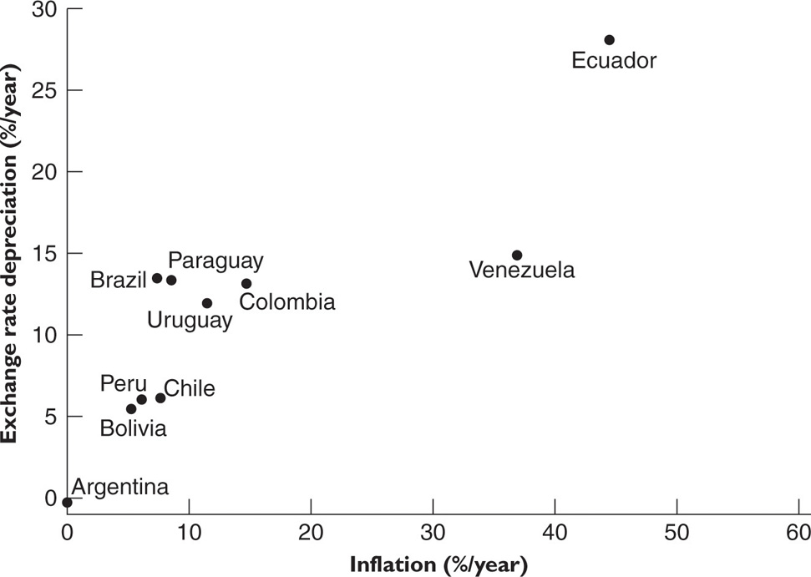
Inflation and Currency Depreciation in South America, 1995-2004
45º
line

Slide 33
PPP Theory
Shortcomings of the PPP Theory
  The theory works well in the long run but not the short run
Limits to the PPP Theory
  Transport cost and trade restriction exists
  Not all goods and services are traded internationally
    The greater the share of non-traded goods, the less precise the PPP theory
      For example, the market for haircuts is very local
  Not all internationally traded goods and services are perfectly standardized commodities

Slide 34
International Trade
Trade is important even to a large economy such as the U.S and China.
Free trade based on comparative advantage (producing a product with lower opportunity cost) maximizes social welfare.
Trade and capital flows are easily politicized
  Free trade can be seen to cost U.S. jobs
  Foreign control of "essential" assets such as ports or telecommunications infrastructure may affect national security
Trade restriction (protectionism) is common among economies

Slide 35
Trade Balance
Trade balance is another name for net exports (NX)
  Value of a country's exports minus the value of its imports
A trade surplus is a positive trade balance
  Exports > imports
A trade deficit is a negative trade balance
  Imports > exports

Slide 36
Capital Flows
International capital flows are purchases or sales of real and financial assets across international borders
  Capital inflows are purchases of domestic assets by foreign households and firms
  Capital outflows are purchases of foreign assets by domestic households and firms
  Net capital inflows (KI) are capital inflows minus capital outflows
Capital flows are not counted as imports or exports since they refer to the purchase of existing assets rather than currently produced goods and services

Slide 37
Trade Balance (NX) and Net Capital Inflows (KI)
NX + KI = 0
U.S. resident purchases Japanese car for US$20,000
  Imports = US$20,000
Manufacturer holds US$20,000 in a U.S. bank account
  Option 1: purchase US$20,000 of U.S. goods and services so exports = US$20,000
  Option 2: purchase U.S. bonds or U.S. real estate
    NX = – US$20,000, KI = US$20,000
  Option 3: sell US dollars for yen
    Follow the US dollars and see what the purchaser does with them to determine NX and KI

Slide 38
International Capital Flows
Highly developed financial markets allow borrowing and lending across borders
Transactions are subject to laws in the originating country and the target country
  Size of international flows for a country depend on its regulations and laws
  Also depend on economic integration and political stability
Lending is acquiring a real or financial asset
  Buying a share of stock or a government bond or a parcel of land
Borrowing is selling a real or financial asset

Slide 39
Two Roles of International Capital Flows
Trade Imbalances
International capital flows compensate for trade imbalances
Trade surplus means net capital outflows
Efficient Allocation of Savings
International capital flows allow savers to invest in the most profitable opportunities
Fills savings gap in destination country
Trade deficit means net capital inflows
Independent of location

Slide 40
International Capital Flows
KI
KI < 0
Net capital
outflows
Domestic Real
Interest Rate (r)
KI > 0
Net capital
inflows
0
Net Capital Inflows (KI)
Capital inflows to the U.S. include foreign purchases of
  Stocks and bonds of U.S. companies
  U.S. government bonds
  Real assets such as land and buildings owned by US residents
Capital flows respond to real
interest rates
  Higher domestic interest
  rates mean greater capital
  inflows

Slide 41
Risk and Capital Inflows
For a given real interest rate, increase in riskiness of domestic assets decreases capital inflows
  Shifts the capital inflow curve to the left
  Foreigners are less willing to buy domestic assets
  Domestic savers are more
  willing to buy foreign
  assets
KI'
KI
Domestic Real
Interest Rate (r)
0
Net Capital Inflows (KI)

Slide 42
Savings, Investment, Capital Inflows
Definition of output
  Y = C + I + G + NX
Solve for I
Y – C – G – NX = I
National savings, S, is (Y – C – G)
S – NX = I
Also
NX + KI = 0 OR KI = – NX
So
S + KI = I

Slide 43
S + KI = I
Savings plus net capital inflows equals investment in new capital goods
  Foreign savings can supplement domestic savings to create capital goods to
  support economic growth
In a closed economy,
S = I
In an open economy,
S + KI = I
Capital inflows mean more
investment and lower
interest rates
S
S + KI
Real interest rate (%)
r*
I
S, I
Saving and investment

Slide 44
Saving Rate and Trade Deficit
What causes trade deficits?
  Not the production of inferior goods
  Not the result of unfair trade restrictions
  A low rate of national saving is the primary cause
Recall S – I = NX
  Hold I fixed
  High level of S implies a high level of NX
  Low level of S implies a low level of NX

Slide 45
Saving Rate and Trade Deficit
Low rate of national saving is associated with a trade deficit
  Low savings implies high spending
  High spending includes more spent on imports
  High domestic spending leaves less available for export
  High imports and low exports creates trade deficit
Trade deficit country receives capital inflows
  Lack sufficient saving to finance domestic investment
  Interest rate will rise and attract capital inflows
  Trade deficits are not a problem as long as the economy continues to grow

Slide 46
Thank You
This is the end of Lecture 12.
Thank you for your participation.
Please send your query to me via my email at khayboon@ntu.edu.sg.

